Slide 1
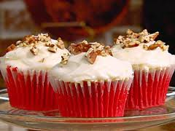
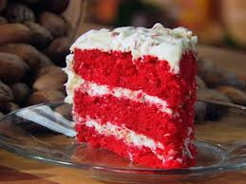
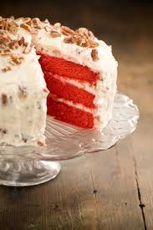
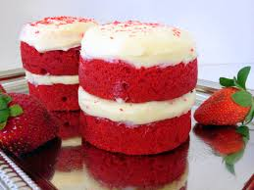
Red Velvet Cake
By: Kyra Dudley and Tracye Chambers
Dr. Livingston
11.5.14

Slide 2
Recipe for red velvet cake
2 1/2 cups all-purpose flour (recommended: White Lily)
1 teaspoon baking soda
1 teaspoon cocoa
1 1/2 cups granulated sugar
2 eggs
1 1/2 cups canola oil
1 teaspoon vinegar
1 (1-ounce) bottle red food coloring
1 teaspoon vanilla
1 cup buttermilk

Slide 3
Recipe for cream cheese frosting
1/2 cup margarine
1 (8-ounce) package cream cheese
1 box confectioners' sugar, sifted
1/2 teaspoon vanilla
1 cup chopped lightly toasted pecans

Slide 4
Summarizing Ingredients Table
Ingredients Original 1/2 Double (2x) Quadruple (4x)
Flour 2½ 1½ 5 10
Baking Soda 1 ½ 2 4
Cocoa 1 ½ 2 4
Granulated Sugar 1½ ¾ 3 6
Eggs 2 1 4 8
Canola Oil 1½ ¾ 3 6
Vinegar 1 ½ 2 4
Red food coloring 1 ½ 2 4
Vanilla 1 ½ 2 4
Butter Milk 1 ½ 2 4
Butter Milk

Slide 5
Explanation of adjustment
There are 6 servings out of 27 students. What we would have to figure out is how many servings are there for one person. How you would figure that out is that you would have to multiply all your original ingredients by 6 , then multiply that by how many students in your class which we have 27.

Slide 6
Thank you

